Slide 1
Ansible
Gopal Naganaboyina
Gurpreet Gill
February, 2019

Slide 2
Agenda
Introduction
Networking Modules
Playbooks
Ansible Tower
Ansible Galaxy
Lab Demo
Reference

Slide 3
Introduction

Slide 4
Introduction
Objective
Introduce Ansible
Get a view of a typical automation system, so you can position DNAC appropriately
Methodology
High level lecture
Optional hands-on lab for closer look

Slide 5
What is Ansible
Open-source automation platform
Efficient automation of:
Software provisioning
Configuration management
Application deployment
Agentless
Doesn’t need any agent running on the managed devices

Slide 6
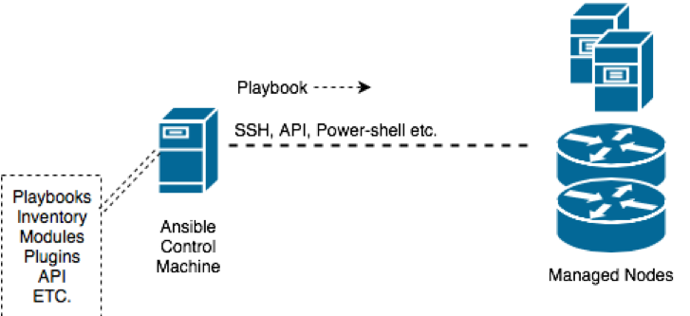
What is Ansible
Automation model: 2 components
Ansible Control Machine: Linux server with Ansible SW
Managed devices: Devices that are being automated by Ansible.
Ansible Control Machine talks to devices over SSH
Supports other transports
Only requirement on network devices: enable SSH

Slide 7
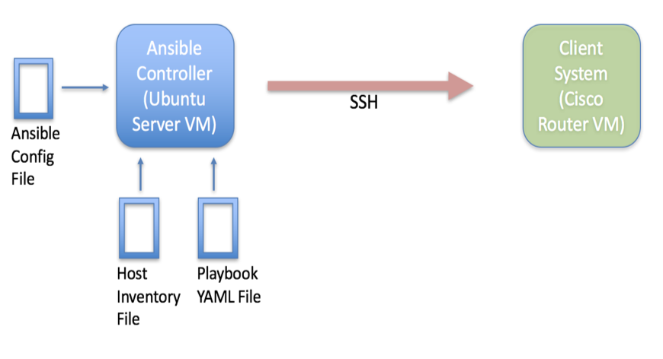
Common Files
Config file
Inventory file
Playbook file

Slide 8
Ansible Concepts: Config File
File to tune Ansible environment
To find your Ansible config file, do:
$ ansible --version
Other methods to customize:
Multiple config files
Environmental settings
Command line options
Roles

Slide 9
Ansible Concepts: Inventory File
Managed device info is saved in inventory file
Device info can be listed as individual hosts or groups
Variables can be assigned to hosts or groups
Well-known group names:
all
ungrouped
Example:
$ cat /etc/ansible/hosts
[IOS]
172.16.101.91 ansible_user=cisco ansible_ssh_pass=cisco
[XR]
172.16.101.92 ansible_user=cisco ansible_ssh_pass=cisco
[ALL:children]
IOS
XR

Slide 10
Ansible Concepts: Modules
Modules are the nuts and bolts of Ansible automation tasks
Playbooks use Modules to execute tasks on the managed devices
Modules are Operating System specific.
ios_command
junos_config
$ ansible IOS -m raw -a “show ip route sum”
$ cat ios_sh_ip_route_sum.yml
---
- name: route summary from IOS devices
hosts: IOS
gather_facts: false
tasks:
- raw: sho ip route summary

Slide 11
Ansible Concepts: YAML
YAML is a data serialization language
YAML = YAML Ain't Markup Language
YAML is intuitive and human readable
Ansible playbooks are written in YAML

Slide 12
Ansible Concepts: YAML
Key-value-pair is represented as:
<key><colon><space><value>
List: “ordered data”, represented as:
<dash><space><data>
Dictionary: “non-ordered data”
Bunch of key-value pairs
There can be list of dictionaries and dictionary of lists
Key-value pair
platform: ASR9K
List
- show ip int brief
- show ip route summ
Dictionary
name: Verify Router OS
hosts: IOS
gather_facts: false
connection: local

Slide 13
Ansible Concepts: Playbooks
Example structure:
- name: play1
hosts: group1
tasks:
- module1: parameters
- module2: parameters
- name: play2
hosts: group2
tasks:
- module1: parameters
- module2: parameters
Playbooks are the main means of Ansible automation.
Playbook is a collection of plays
Each play is a collection tasks
Each task is a collection of modules

Slide 14
Ansible Concepts: Playbooks
Example structure:
- name: play1
hosts: group1
tasks:
- module1: parameters
- module2: parameters
- name: play2
hosts: group2
tasks:
- module1: parameters
- module2: parameters
Playbooks are the main means of Ansible automation.
Playbook is a collection of plays
Each play is a collection tasks
Each task is a collection of modules

Slide 15
Ansible Concepts: Playbooks
Example structure:
- name: play1
hosts: group1
tasks:
- module1: parameters
- module2: parameters
- name: play2
hosts: group2
tasks:
- module1: parameters
- module2: parameters
Playbooks are the main means of Ansible automation.
Playbook is a collection of plays
Each play is a collection tasks
Each task is a collection of modules
Target
Action

Slide 16
Basic Playbooks

Slide 17
Basic Playbooks: ios & xr command module
Module Names: ios_command & iosxr_command
Module sends exec command to remote devices and returns the results
Both modules require local connection execution method
Required Parameters for ios & xr command module:
- commands option : specify router command to retrieve data

Slide 18
ios_command
iosxr_command
---
- name: IOS Module Router Config
hosts: IOS
gather_facts: false
connection: local
tasks:
- name: Collect version info
ios_command:
commands:
- show version
register: ABC
- debug: var=ABC.stdout_lines
---
- name: XR Module Router Config
hosts: XR
gather_facts: false
connection: local
tasks:
- name: Collect version info
iosxr_command:
commands:
- show version
register: XYZ
- debug: var=XYZ.stdout_lines

Slide 19
Basic Playbooks: Register & Debug
Register
- The “register” statement is used to capture the output of a task into a variable.
- In previous example, we are saving the output of the show commands to the variables, named ABC and XYZ.
- Refer: http://docs.ansible.com/ansible/latest/playbooks_conditionals.html#register-variables
Debug
- The “debug” module prints statements during playbook execution.
- The ”debug” modules takes in a var parameter, which is the variable you want to print.
- Refer: http://docs.ansible.com/ansible/latest/debug_module.html

Slide 20
Basic Playbooks: ios & xr config module
Module Names: ios_config & iosxr_config
The config modules are used to configure the cisco routers.
The modules uses parent and line options to structure the configuration in a hierarchical way.
Both modules require local connection execution method.

Slide 21
ios_config
iosxr_config
---
- name: IOS Module Router Config
hosts: IOS
gather_facts: false
connection: local
tasks:
- name: Configure Interface Setting
ios_config:
parents: "interface Ethernet1”
lines:
- "description test”
- "ip address 172.31.1.1 255.255.255.0”
---
- name: XR Module Router Config
hosts: XR
gather_facts: false
connection: local
tasks:
- name: Configure Interface Setting
iosxr_config:
parents: "interface GigabitEthernet0/0/0/0”
lines:
- "description test”
- "ip address 172.31.1.1 255.255.255.0”

Slide 22
Basic Playbooks: Variables
---
- name: IOS Module Router Config
hosts: IOS
vars:
INTF: ethernet1
IP: 172.31.1.1
MASK: 255.255.255.252
tasks:
- name: Configure Interface Setting
ios_config:
parents: "interface {{INTF}}”
lines:
- "ip address {{IP}} {{MASK}}”
Ansible variables are used to store information that will change with each host.
Variable can be defined:
inventory file (ansible_host), or
created directly in the playbook, or
created in a separate file and included within the playbook.
Variables are defined in playbooks
Using“{{ }}” the single/double quotes around double curly brackets
Using {{ }} the double curly brackets if its part of a sentence/string

Slide 23
Basic Playbooks: Loops
tasks:
- name: Collect Rtr info
ios_command:
commands:
- show version
- show inventory
Ansible loops are used when performing a task repeatedly
Key words used: item, loop
Using Loop:
tasks:
- name: Collect Rtr info
ios_command:
commands: "{{ item }}"
loop:
- show version
- show inventory

Slide 24
Basic Playbooks: Conditionals
Ansible conditionals are used in a statement to decide whether to run the task or not.
Ansible uses a when clause to dictate a conditional which needs to be true in order for the task to be performed.
tasks:
- name: Collect Router Version
ios_command:
commands:
- show ip int bri
when: ansible_user == "cisco"

Slide 25
Ansible Tower

Slide 26
Ansible Tower
Commercial product by Red Hat
Targeted at mid/large enterprises
Web based, with GUI and visual dashboard
Handles large user base with varying skill levels
Features include:
Role-based access control
Job scheduling
integrated notifications
Graphical inventory management
REST API and CLI

Slide 27
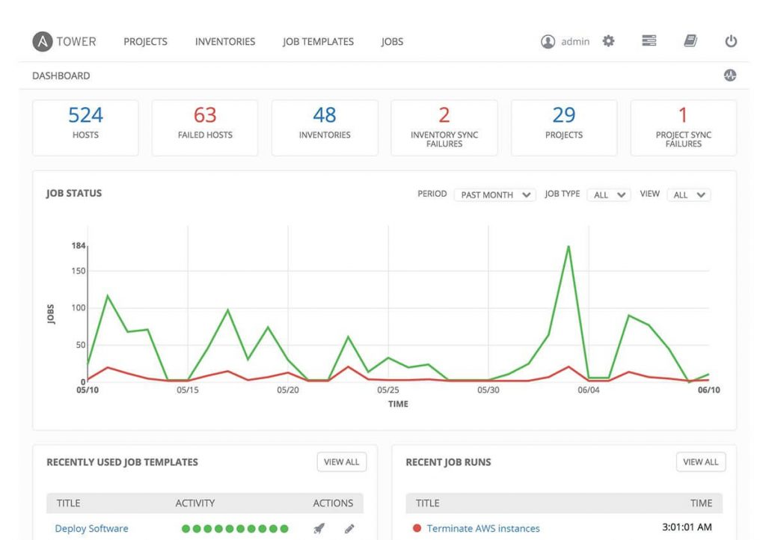

Slide 28
Ansible Galaxy

Slide 29
Ansible Galaxy
User community hub
Open source playbooks
Create, find, and share content with the community
Typical Linux style contribution

Slide 30
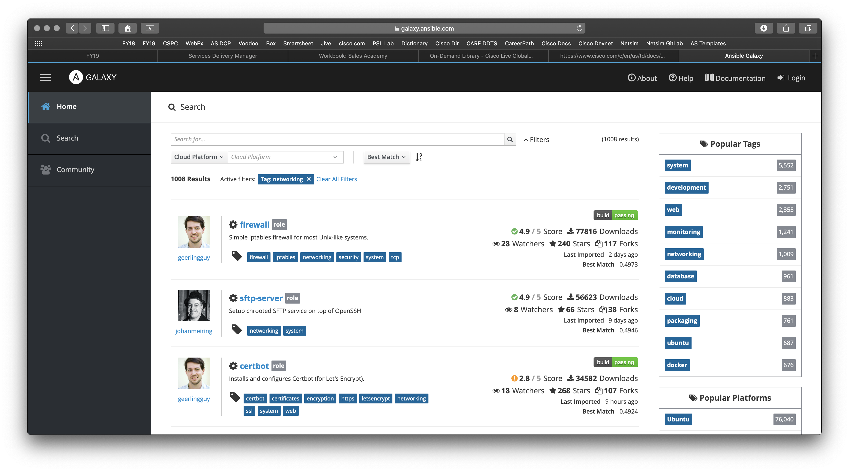

Slide 31
Conclusion
Ansible is an open-source, agentless automation tool that can be leveraged for networks configuration management functions.
Ansible-playbooks provides capabilities to automate daily operations tasks.
Automating repetitive tasks with Ansible can reduce OPEX costs and improve efficiency.
With increasing support of modules, it is possible to automate even more network functions through Ansible.

Slide 32
Network Automation- Lab Demo

Slide 33
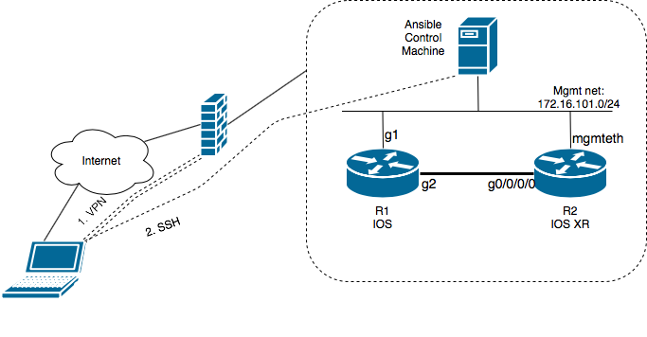
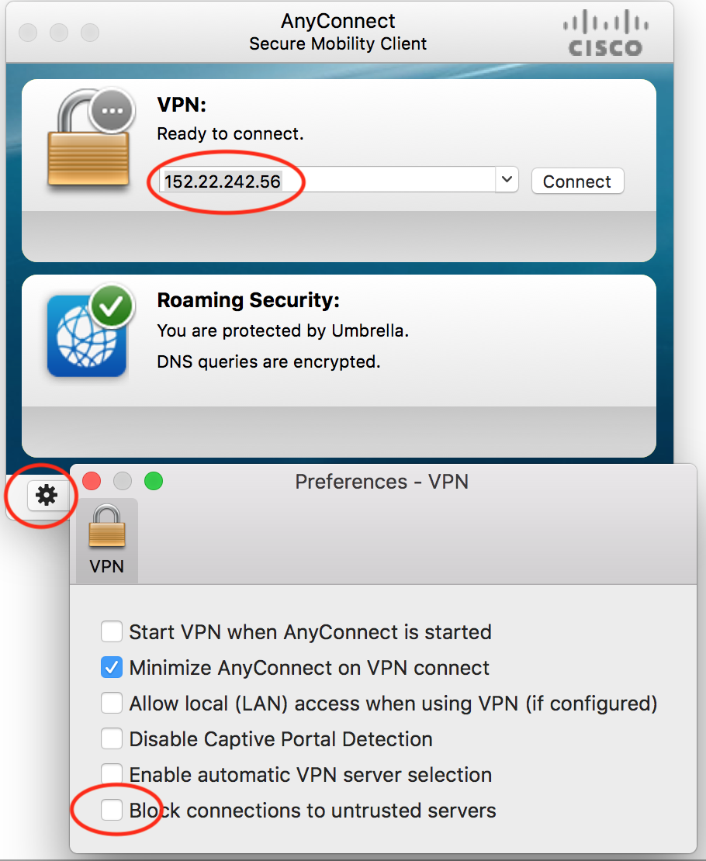
Lab topology and access info
Lab info
VPN server
Ansible controller
R1 IOS router
R2 XR router
LAB access
Use Cisco-Anyconnect client to VPN-into the lab
Type in lab VPN server IP address
Click on settings-wheel and uncheck "block connections to untrusted servers

Slide 34
Lab Guide
Ansible .cfg file
grep -v "#" /etc/ansible/ansible.cfg | grep -v ^$
[defaults]
inventory = /etc/ansible/hosts <14>
gathering = explicit <36>
host_key_checking = False <71>
timeout = 10 <103>
deprecation_warnings = False <180>
retry_files_enabled = False <257>
[inventory]
[privilege_escalation]
[paramiko_connection]
[ssh_connection]
[persistent_connection]
[accelerate]
[selinux]
[colors]
[diff]
[defaults]
[inventory]
[privilege_escalation]
[paramiko_connection]
[ssh_connection]
[persistent_connection]
[accelerate]
[selinux]
[colors]
[diff]

Slide 35
Lab Guide
Host file
cat /etc/ansible/hosts
[IOS]
R1 ansible_host=172.16.101.XX ansible_user=cisco ansible_ssh_pass=cisco
[XR]
R2 ansible_host=172.16.101.XX ansible_user=cisco ansible_ssh_pass=cisco
[ALL:children]
IOS
XR

Slide 36
Network Automation Exercises
Exercise 1 – Execute show commands with Ansible Playbook
Create Ansible playbook to access router and execute show commands
Use similar playbook and add verbose details of the show commands
Exercise 2 – Automatically backup router’s config to server daily
Create Ansible playbook to capture router’s running config from all Cisco device types.
Setup cron job to execute playbook daily and backup router’s config on server.
Exercise 3 – Create a playbook get device health check
Create Ansible playbook to run health checks on devices
Exercise 4 – Ansible Vault
Use ansible-vault feature to encrypt sensitive data in inventory files.

Slide 37
Reference

Slide 38
Reference
Ansbile user guide URL
Ansible installation URL
YAML resources
http://docs.ansible.com/ansible/latest/YAMLSyntax.html
http://www.yaml.org
https://www.youtube.com/watch?v=cdLNKUoMc6c
https://www.youtube.com/watch?v=U9_gfT0n_5Q
Ansible Training
Ansible for the Absolute Beginner @Udemy Click here
Ansible for Network Engineers @Udemy Click here
Kirk Byers Ansible training Jive page
Dcloud lab Ansible for Cisco Nexus Switches v1

Slide 39
Acknowledgements

Slide 40
Acknowledgements
Some material in this session are sourced from Ansible docs
http://docs.ansible.com/ansible/latest/index.html

Slide 41
Backup Slides

Slide 42
Ansible Roles

Slide 43
Playbook
Efficient Usage
---
- name: output from IOS routers
hosts: XR
gather_facts: false
connection: local
vars:
INTF: loopback1
tasks:
- name: read config
iosxr_command:
commands: show run int {{INTF}}
register: DATA
- name: print output
debug: var=DATA.stdout_lines
We can simplify
Playbook of playbooks
We can modularize
vars
tasks
And other components
We can reuse
Modularize components that are used repeatedly

Slide 44
Playbook of playbooks
We can call playbooks within a playbook
Playbook to acquire data from IOS and XR devices:
---
- name: ios config
import_playbook: basic_ios_cmd.yml
- name: xr config
import_playbook: basic_xr_cmd.yml

Slide 45
Roles
[roles/
├── xr-ospf >> Name of this role
│ ├── defaults >> default variables for the role
│ │ └── main.yml
│ ├── files >> contains files which can be deployed
│ ├── handlers >> contains handlers
│ │ └── main.yml
│ ├── meta >> defines some meta data for this role
│ │ └── main.yml
│ ├── README.md
│ ├── tasks >> contains the list of tasks
│ │ └── main.yml
│ ├── templates >> contains templates which can be deployed
│ └── vars >> contains variables used in this role
Organize a large playbook into reusable file structures
Creates a separation of functions; variables, tasks, & templates in unique directories
Expects files main.yml, and .j2 files in respective folders
File structure can be created manually or automatically via ansible CLI – “ansible-galaxy”
Notes:
Ansible directory structure is important in ansible especially with roles.
Galaxy, is a free site for searching, downloading, and sharing community developed roles. You can create your own roles and publish them on the ansible-galaxy website, allowing other users to download and use your role.

Slide 46
Roles Style Config
---
- name: play-1-output from IOS routers
hosts: XR
gather_facts: false
connection: local
vars:
INTF: loopback1
tasks:
- name: read config
iosxr_command:
commands: show run int {{INTF}}
register: DATA
- name: print output
debug: var=DATA.stdout_lines
[roles/
├── xr-ospf >> Name of this role
│ ├── defaults >> default variables for the role
│ │ └── main.yml
│ ├── files >> contains files which can be deployed
│ ├── handlers >> contains handlers
│ │ └── main.yml
│ ├── meta >> defines some meta data for this role
│ │ └── main.yml
│ ├── README.md
│ ├── tasks >> contains the list of tasks
│ │ └── main.yml
│ ├── templates >> contains templates which can be deployed
│ └── vars >> contains variables used in this role

Slide 47
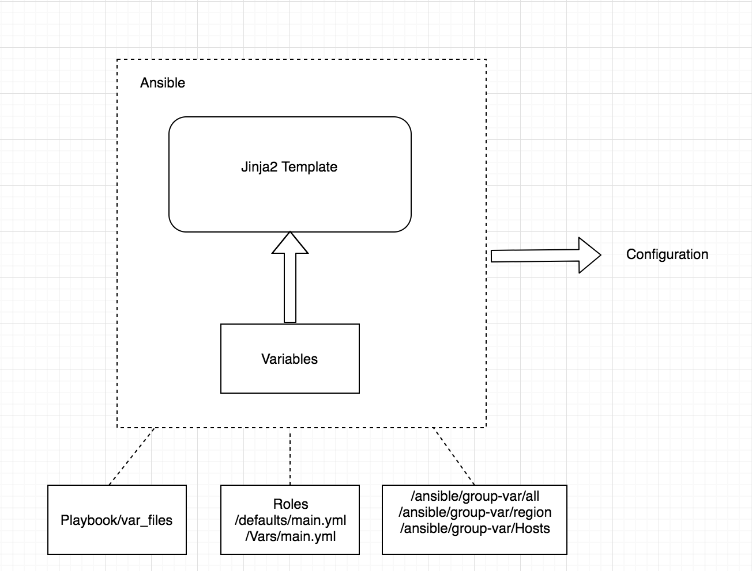
Config Generation Using Templates
Templates contain common and device/role specific elements
Ansible uses Jinja 2 templating language for access to variables and logic/dynamic expression
Jinja 2 template files end with .j2 ext
Ansible can automatically access the Jinja2 templates through its Python API
Notes:
when playbooks are run, variables are inserted into jinja2 templates, we get the configuration test as output
variables are global/regional variables are inserted into templates - Jina2 templates wrapped around variables/templates is ansible
Ansible removes/abstracts complexities from end user
jinja2 templates are python libraries and pytohon api

Slide 48
Role with lists with single variables – Example 1
Creating a role to generate configuration across multiple devices
- name: execute xr-config role
hosts: localhost
gather_facts: no
roles:
- xr-config
# playbook for executing role of xr-config
# Executes main.yml in xr-config/tasks/main.yml
- name: Generate the configuration from templates
template: src=xr-config-template.j2 dest=/home/cisco/{{item.hostname}}.txt
with_items:
- "{{ router_hostname }}"
# tasks file for xr
# Variable defined in xr-config/vars/main.yml
---
router_hostname:
- { hostname: router1 }
- { hostname: router2 }
- { hostname: router3 }
...
# Leverages j2 template for standard and variable config
hostname {{item.hostname}}
service timestamps log datetime msec
service timestamps debug datetime msec
clock timezone {{item.timezone}} {{item.timezone_offset}}
clock summer-time {{item.timezone_dst}} recurring
Notes:
Before we start using variables it’s important to know what are valid variable names. Variable names should be letters, numbers, and underscores. Variables should always start with a letter.You might have some templates for configuration files that are mostly the same, but slightly different based on those variables.Variables in Ansible are how we deal with differences between systems.

Slide 49
Jinja2 Template – For loop
For Loop is a continuous loop until it runs out of inputs variables
For Loop is invoked using {% for x in y %} syntax and ends with {% endfor %} syntax
# /template/template.j2
{% for INTF in interface_list %}
interface {{INTF}}
cost 1
!
{% endfor %}
!
# /vars/main.yml
Interface_list:
- GigabitEthernet0/0/0/0
- GigabitEthernet0/0/0/1

Slide 50
Hierarchical templates and Block configs
Base template *.J2 is pulled to specific template through {% extends ”base_config_template.j2" %} knob
Configurations from specific template are inserted through block configs that being with { % block x %} and end with { % endblock % }
## Config lines from lsr_config referring base template
{% extends "ler_lsr_config_template.j2" %}
#/templates/ lsr__config.j2
{% block rsvp %}
!
rsvp
{% for interface in interface_list_ler %}
interface {{interface}}
bandwidth percentage 100
!
{% endfor %}
{% endblock %}
#/templates/ ler_lsr_config_template.j2
hostname {{item.hostname}}
service timestamps log datetime msecservice timestamps debug datetime msectelnet vrf default ipv4 server max-servers 10telnet vrf Mgmt-intf ipv4 server max-servers 10domain name virl.infodomain lookup disablecdp
{% block rsvp %}
{% endblock %}
!,,

